Slide 1
GST Compliance Solution
(as part of Cash Management Services)
An overview

Slide 2

1. GST compliance process & imperative

Slide 3

Overview of GST
GST is a consumer based tax, implemented to club indirect taxes imposed on the goods and services. It will simplify and rationalize the indirect tax regime in India
GST (Goods and service tax) is levied on goods and services sold for domestic consumption to generate revenue for the government.
If the supply qualifies as an export of goods/services i.e., zero rated supply, upon fulfilment of prescribed conditions, GST would not be applicable on the same
GST will also reduce the burden of cumulative taxation by providing credits for input tax. In this system, the consumer will only pay for the GST charged by the last dealer.
GST will be paid to both the Centre and the States depending upon the manufacturing and consuming side of the goods and services.

Slide 4

Eliminating the cascading effect of taxes
GST would replace the existing tax structure where tax is paid on tax at every level in the supply chain and the value of item keeps on increasing.
In the new tax structure, tax credit could be claimed at every stage. The idea behind GST is “One Nation One Tax”, i.e. no inter-state barrier
Making unified law and decreasing unhealthy competition among the states.
Reducing cost of production by making tax on inputs fully creditable.
Increasing tax compliance - As all the GST related services such as registration, payment and refund would be made available online, it would make the system more transparent and make compliance easy.
Establishing an economically efficient and neutral tax system.

Slide 5
Taxes at centre and state level subsumed into GST
Taxes at Centre and state level subsumed into GST
At the Central level, the following taxes are being subsumed:
Central Excise Duty.
Additional Excise Duty
Service Tax
Additional Customs Duty commonly known as Countervailing Duty
Special Additional Duty of Customs.
At the State level, the following taxes are being subsumed:
Subsuming of State Value Added Tax/Sales Tax
Entertainment Tax (other than the tax levied by the local bodies)
Central Sales Tax (levied by the Centre and collected by the States
Entry tax
Purchase Tax
Luxury tax
Taxes on lottery, betting and gambling.
Central excise duty
Service tax
Additional excise duty
Additional custom duty
Surcharges and cesses
Central taxes
CGST
State taxes
State VAT
Sales tax
Entry tax
Purchase tax
Entertainment tax
Surcharges and cesses
SGST

Slide 6
What are CGST, SGST and IGST?
India is a federal democracy that is one which has clear demarcation of powers, responsibility and revenue collection between the states and the Centre in its constitution.
For example law and order falls under the state’s jurisdiction while the nation’s defense is the Centre's responsibility.
The GST too needs to have clear provisions on what areas the Centre and the state are allowed to collect revenue from taxation to prevent an overlapping.
SGST credit can be utilized against SGST and IGST libality
CGST
SGST
IGST
IGST credit can be first utilized against IGST liability. The remaining IGST credit can be used against CGST liability and then against SGST liability
CGST credit can be utilized against CGST and IGST libality

Slide 7
Taxes subsumed in IGST
Taxes subsumed in IGST
CGST
The Central GST or CGST is the areas where the Centre has the powers and State GST where the State has taxation capabilities.
The IGST or Integrated GST is for movement of goods within the states of the Indian union. This will be collected by the union however will be transferred over to the states.
In case of cross-border transactions, where the supplier is located in India and the place of supply of goods/services is outside India, the transaction shall be treated as supply in the course of inter-state trade or commerce and accordingly, IGST is to be charged on the same
However, where such supply qualifies as export of goods/ services i.e., zero rated supply, upon fulfilment of the prescribed conditions, no IGST would be applicable on the same
IGST
SGST

Slide 8
GST return types
GST return types
Outward supply of taxable goods and services
Return for Non-Resident foreign taxable person
GSTR 1
GSTR 5
Details of supplies auto drafted from GSTR-1, 6, 7 or 8 to recipient
Return for Input Service Distributor
GSTR 2A
GSTR 6
Inward supply of taxable goods and services.
Return for authorities deducting tax at source
GSTR 2
GSTR 7
GSTR 1A
Actions on GSTN transactions
GSTR 8
Details of supplies effected through e-commerce operator
Monthly returns excluding compounding tax payer and ISD
GSTR 9
Annual Return
GSTR 3
Final Return for taxable person whose registration has been surrendered or cancelled
GSTR 4
Quarterly Return for Compounding taxable person
GSTR 10

Slide 9
Details of different returns
Details of different returns
GSTR 1
It is a Sales Register of Goods and services where details of taxable supplies, nil rate, exempt and non GST outward supplies are entered
HSN code will identify the nature of transaction of the goods and services.
GSTR 2A
Invoice-level inward supply information, rate-wise, pertaining to the tax period reported by supplier in GSTR-1 will be auto-populated in GSTR-2A
GSTR 2
It is a comprehensive purchase register where details of taxable supplies received from registered & unregistered persons, imports, composition taxable persons are entered.
The data of goods purchased from the registered dealer will get automatically populated
GSTR 1A
It is the details of inward supplies added, corrected or deleted by the recipient. The supplier should take necessary actions on the communicated details before the scheduled date of the month
GSTR 3
It is a monthly return form where only adjustment entries and challan information will be entered. Rest information is auto populated from purchase and sales register
GSTR 4
It is a quarterly return for registered persons who have opted for composition levy

Slide 10
Details of different returns contd.
Details of different returns contd.
GSTR 5
It is a monthly return and will be filed by non-resident taxable person. The return would details of import of goods, taxable outward supplies made to registered persons, credit notes, debit notes.
GSTR 6
This return will be filed by Input Service Distributors on a monthly basis.
In Input Service Distribution ledger, credits of CGST, SGST and IGST will be maintained separately
GSTR 7
Tax deductor will be liable to file this return on a monthly basis.
Deductee and transaction information is mentioned with the related challan in which the TDS amount is paid to department, same as TDS return of income tax.
GSTR 8
Tax Collected at source needs to be filed every month and the return needs to be filed by 10th of every month
GSTR 9
GSTR-9 is the annual return to be furnished by registered persons every year. The return should be submitted by 31st December of the next Financial year
It is a monthly return form where only adjustment entries and challan information will be entered. Rest information is auto populated from purchase and sales register
GSTR 10
GSTR-10 is the final return to be filed by a taxable person whose registration has been surrendered or cancelled

Slide 11
2. High level application overview

Slide 12
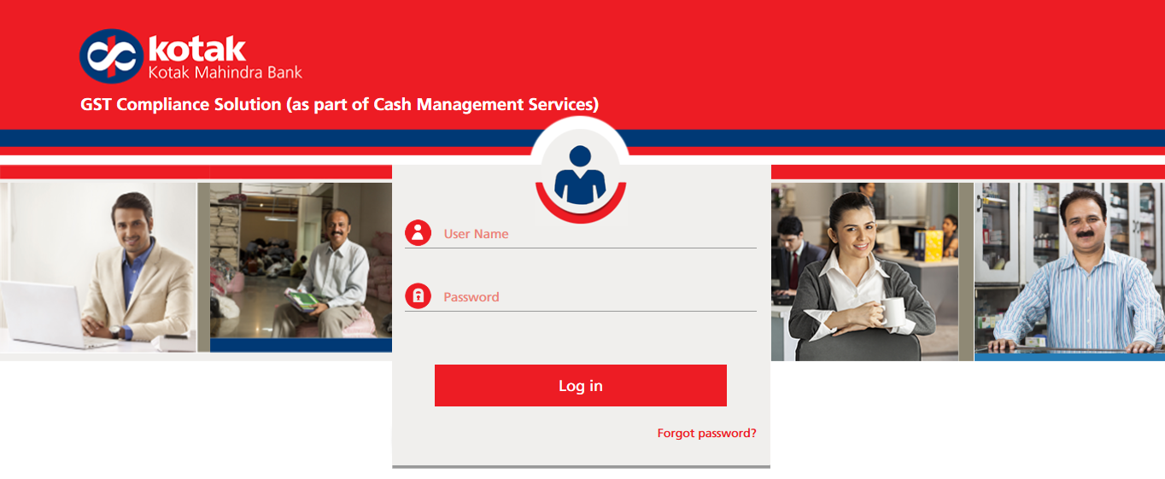
GBI solution overview
GST compliance solution (as part of Cash Management Services) overview
GST Compliance Solution (GCS) is an application that will enable users with the filing of monthly, yearly returns for all GST returns namely Outward Supplies, Inward Supplies, ISD, TDS and TCS.
This software package will assist you in preparing your tax return reports for all the states.
This tool allows the user to import business transactions into GCP to run reconciliations, analysis checks, re-categorize transactions, post adjustments and obtain the final report.

Slide 13
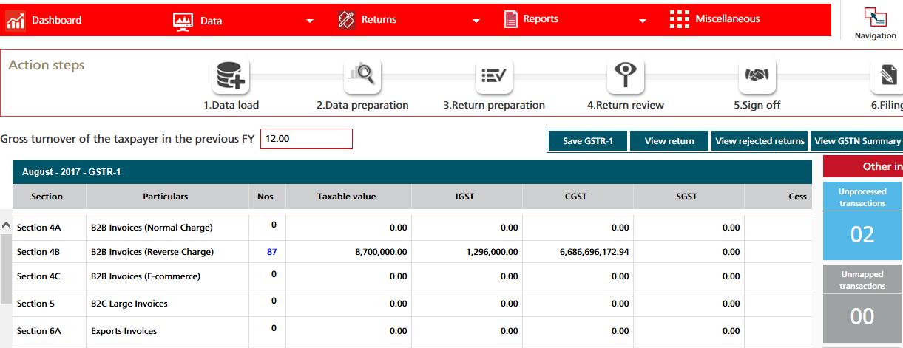
GBI solution overview contd.
GST compliance solution overview contd.
The application loads transactions directly from the finance (SAP, Oracle or Custom ERP) system.
The system uses master data, such as Tax Code Mapping, that is stored within the application making it quicker and easier to compile your GST returns.
This software package will assist you in preparing your tax return reports for all 36 member states.
This tool allows the user to import business transactions into GCP to run reconciliations, analysis checks, re-categorize transactions, post adjustments and obtain the final report.

Slide 14
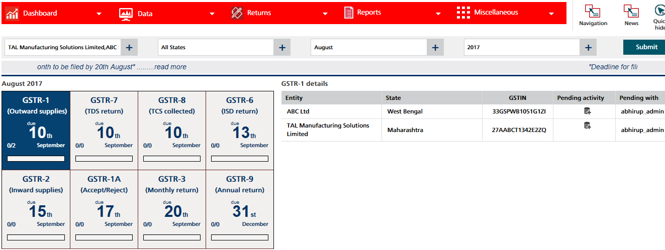
GBI solution homepage
GST compliance solution homepage
The user can apply common prompts/filters to select certain parameters on the main application page.
Once the parameters have been selected, the “Homepage” provides the user with a consolidated overview of uploaded data, GST return filling deadline, Net GST position, unmapped tax codes, number of adjustments and process stage (workflow).
The menu driven workflow on the main page allows the user to complete a series of tasks in sequence.

Slide 15
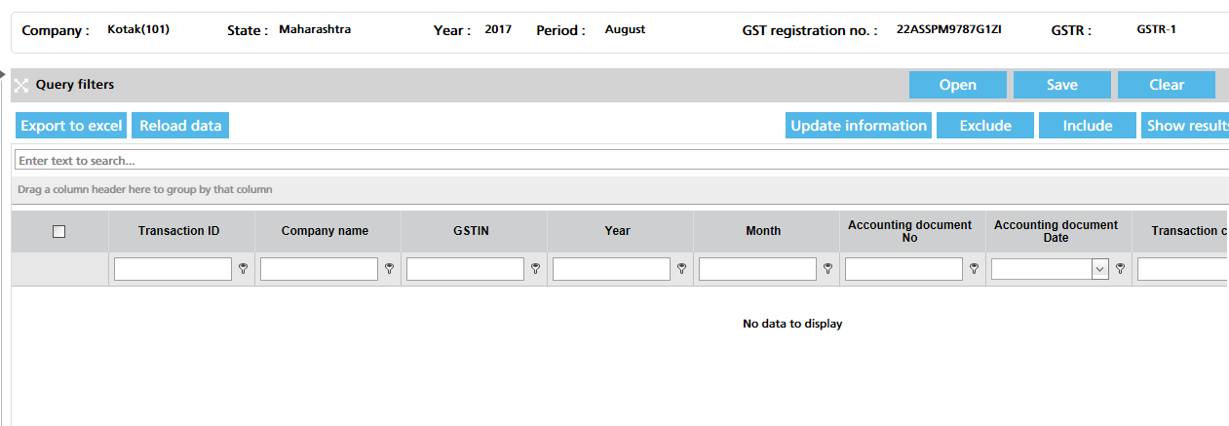
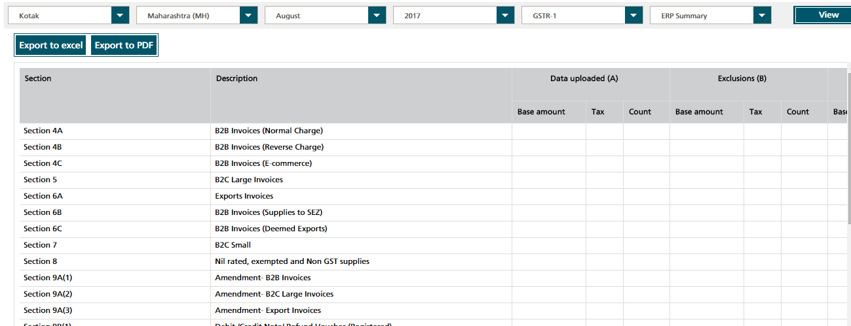
GBI Application overview contd.
GST compliance solution overview contd.
Data Preparation : In the analysis reports, user can review different “Validation Check Reports” including GST business/data checks, legal checks, samples and reconciliation.
Transaction Review Screen :The user can use the “Transaction Review” section to filter data in order to edit transactions, run control checks based on analytical reports, adjust the tax amounts and view reports.
Return Summary : Displays all ERP and GSTN transactions that have been uploaded in the system
Dashboard: It allows the user to view a summary of the transactional data for different GSTR’s based on tax codes, transaction keys etc.
September 17

Slide 16
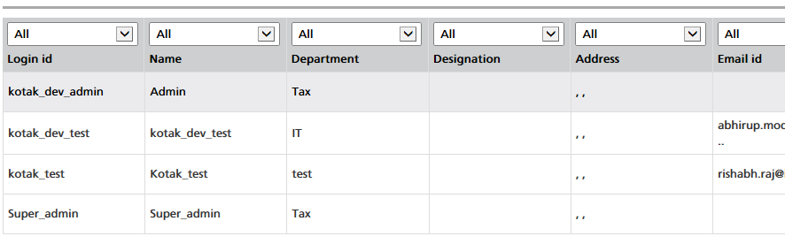
Validation checks and Admin control
Validation checks & Admin control
The user can review different “Validation Reports” including GST business/data checks, legal checks, samples and reconciliation.
Reports allow senior leadership to review and reconcile transactional data at higher levels.
The “Administration” section allows the user to maintain the master data and user access.
September 17
September 17

Slide 17
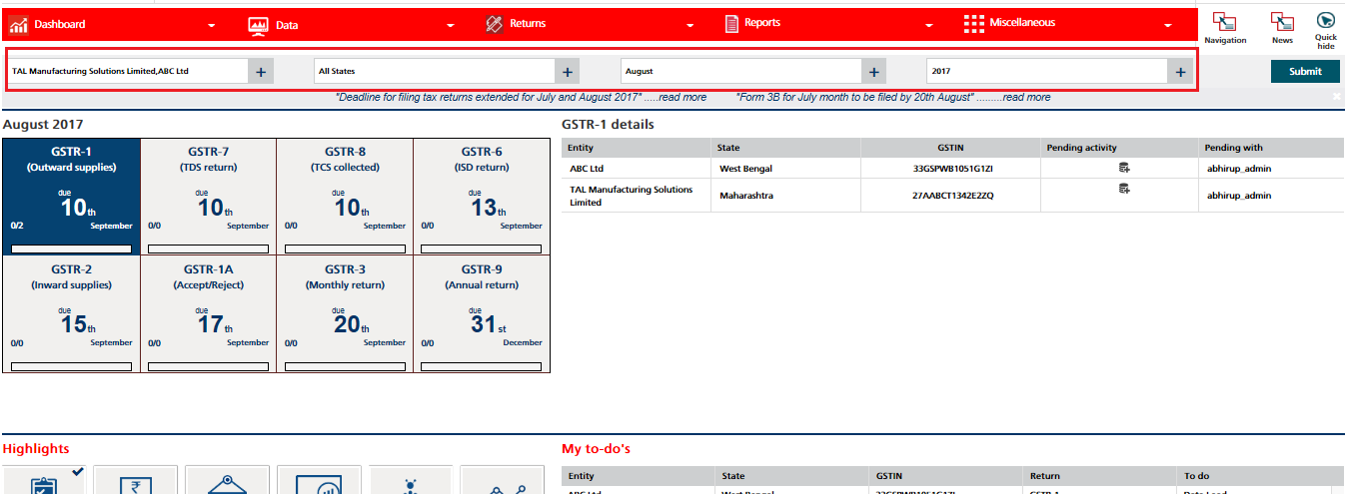
Company level landing page
Company level landing page
Company level landing page criteria is to select a single company e.g.” ABC Ltd” for search for a particular period without selecting any particular state from the dropdown
Select a company, month, year from the drop down. E.g. ABC Ltd , February , 2017
Select a home tile and click on the submit button. E.g. GSTR 1
Observe page displays all the states where data for selected GSTR return is available

Slide 18
Thank You
“This document is prepared for the benefit of customers of Kotak Mahindra Bank (“Bank”). In the preparation of the material contained in this document, the Bank has used information that is publicly available, including information developed in-house. Some of the material used in the document may have been obtained from members/persons other than Bank and/or its affiliates and which may have been made available to Bank and/or its affiliates. Information gathered & material used in this document is believed to be from reliable sources. Bank and any of its officers directors, personnel and employees, shall not liable for any loss, damage of any nature, including but not limited to direct, indirect, punitive, special, exemplary, consequential, as also any loss of profit in any way arising from the use of the information contained in this material, in any manner. Bank however does not warrant the accuracy, reasonableness and/or completeness of any information. All recipients of this material should before using this module referred to in this material make their own investigation and seek appropriate professional advice.”

